Slide 1
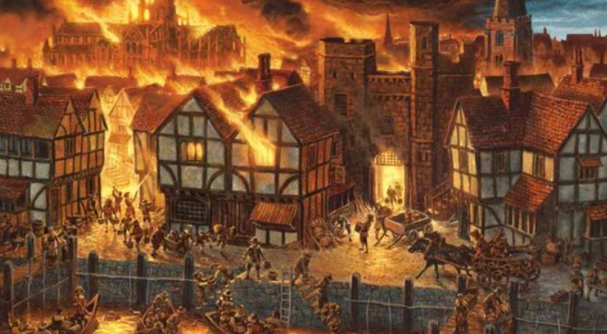
Why was the Great Fire of London so important?
Prior Learning
ELG: Talk about the lives of the people around them and their roles in society;
Know some similarities and differences between things in the past and now,
drawing on their experiences and what has been read in class.
Current Learning – Enquiry questions.
How was London different then to now?
How did the fire start?
Why did it get so big?
Why did it burn for so long?
Could it have been stopped sooner?
How did the Great Fire of London help to overcome the plague?
How did the construction of the buildings help the fire to spread easily?
What changes came about because of the fire?
Future Learning
First Man on the Moon
Relevant links to other curriculum areas:
Design and Technology – Design and make a fire engine.
English – character descriptions/diary entries/ non chronological reports/
NC objective:
Children are taught about
events beyond living memory that are significant nationally or globally.
Topic specific vocabulary:Plague, fire, rats, Samuel Pepys, Fire brigade, Pudding Lane, baker.
Transferable Vocabulary:
Reading sources: Toby and the Great Fire of London, Vlad and the Great Fire of London, Why do we remember The Great Fire of London.
Sparkly start and Enrichment
Indoor firework experience
Fabulous finish:
A living museum and tour all about the Great Fire of London.
Want more information? Please refer to the knowledge organiser!

