Slide 1
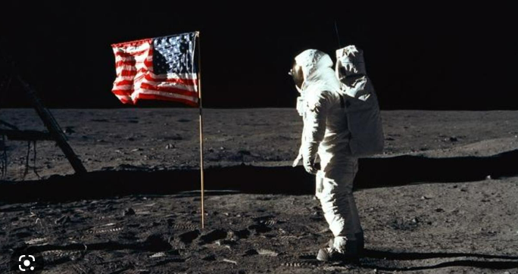
Moon Landing.
Prior Learning
ELG: Talk about the lives of the people around them and their roles in society;
Know some similarities and differences between things in the past and now,
drawing on their experiences and what has been read in class.
Current Learning – Enquiry questions.
Has man ever been to the moon and how can we know for sure?
Why did the astronauts risk their lives to go to the Moon?
How were the spacemen able to get there and back safely?
What did they do when they got to the Moon and how do we know?
Does everyone agree that we should continue to send men to the moon?
How should we commemorate this great achievement?
Future Learning
Science – Space Year 5
Relevant links to other curriculum areas:
Art –Textiles – The Moon, Space art- Peter Thorpe.
English – Stories about going to the moon, Non chronological report – Neil Armstrong.
NC objective:
Changes in living memory and the lives of significant individuals in the past who have contributed to national and
international achievements.
Topic specific vocabulary:
Astronaunt, moon, Neil Armstrong, launched, mission, evidence, Apollo 11,exploration, significant event, space race,NASA.
Transferable Vocabulary: Significant Event, space, evidence, mission.
Reading sources: One Giant Leap, The Sea of Tranquillity, Man on the Moon, Little People, Big Dreams – Neil Armstrong.
Sparkly start and Enrichment
Unveiling of new topic – Moon Landing – jigsaw pieces to put together as class.
Fabulous finish:
Design stamps/ plaques to commemorate the event.
Want more information? Please refer to the knowledge organiser!

