Slide 1
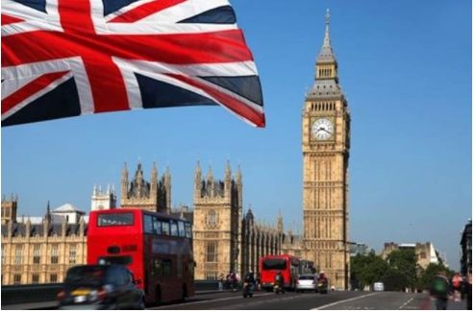
Themes: Human and Physical, Trade, Weather and Climate y3 Geography : The Uk counties and Cities -Who is my neighbour ?
Prior Learning
The UK
Current Learning – Enquiry questions.
Who is my neighbour ?
Can you name the countries of the UK, locate them and their capital cities?
Can you use all 8 points of the compass and map work to locate?
Can you name and locate rivers, seas and mountains of the UK?
Can you name the counties of the UK?
Where is Rutland located?
Do you know how the UK is changing? Brexit, Immigration and Independence
Future Learning
The Uk and Europe
Topic specific vocabulary
Island, Countries,Capital cities, Counties, Uk, Great Britain, Prime meridian, landmark, immigration, Brexit.mountain,hill, range, sea, coast, river.
Europe.
Transferable Vocabulary:
Location,map,compass,north,south, east, west. height.
Government, local , authority, boundary
Reading sources:
Job Role leading to Fabulous finish:
We are….. writers
Our challenge is to create a
Travel brochure on a city in the UK– persuasive write
NC objectives
Name and locate counties and cities of the United Kingdom, geographical regions and their identifying human and physical characteristics, key topographical features (including hills, mountains, coasts and rivers), and land-use patterns; and understand how some of these aspects have changed over time
Relevant links to other curriculum areas:
Art, English, Maths , RE, Music
Sparkly start and Enrichment
Uk Celebration day parade
Uk hats
Heritage day
Want more information? Please refer to the knowledge organiser!

